Slide 1
CSCI5840 Progress presentation

Slide 2
AGENDA
Infrastructure and Visualization
IaC
Unit Testing/ Code Coverage
Demos

Slide 3
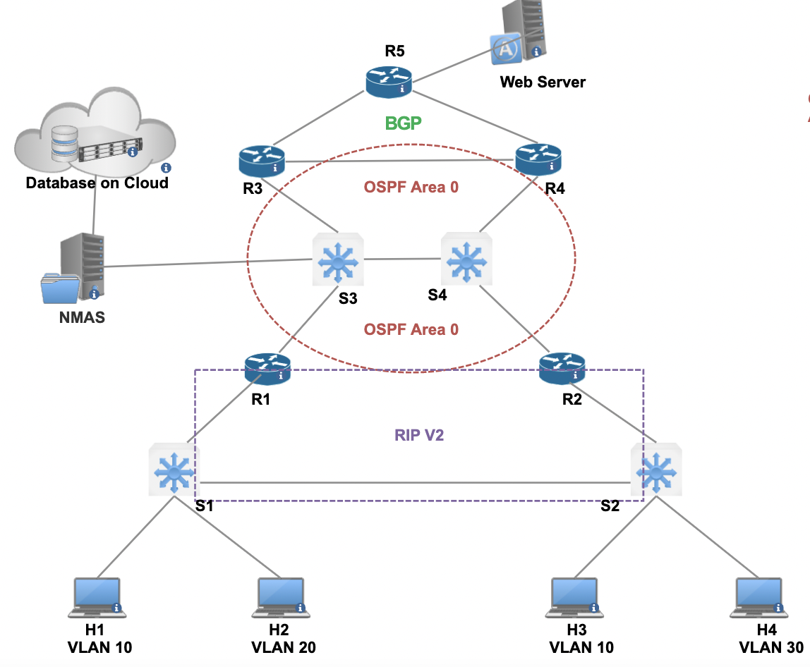
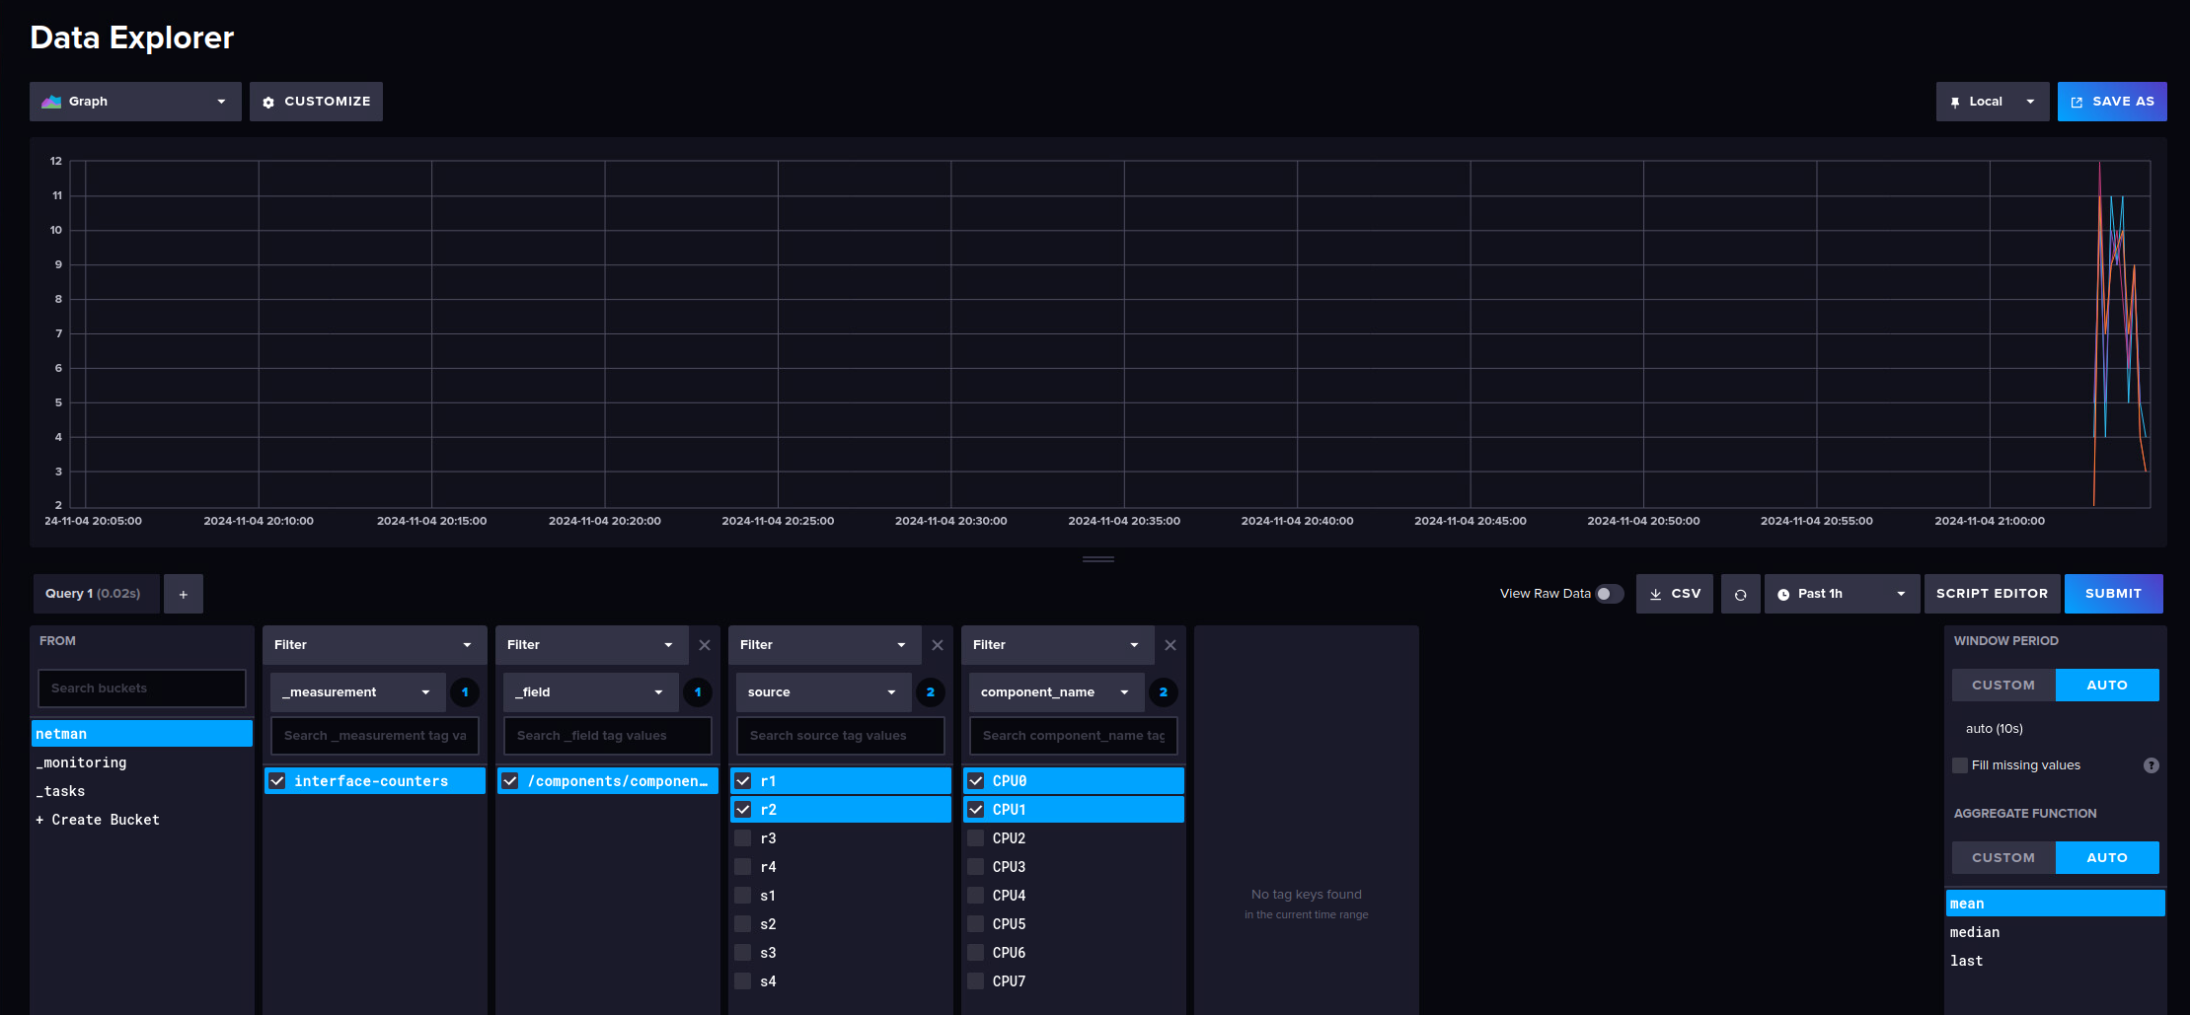
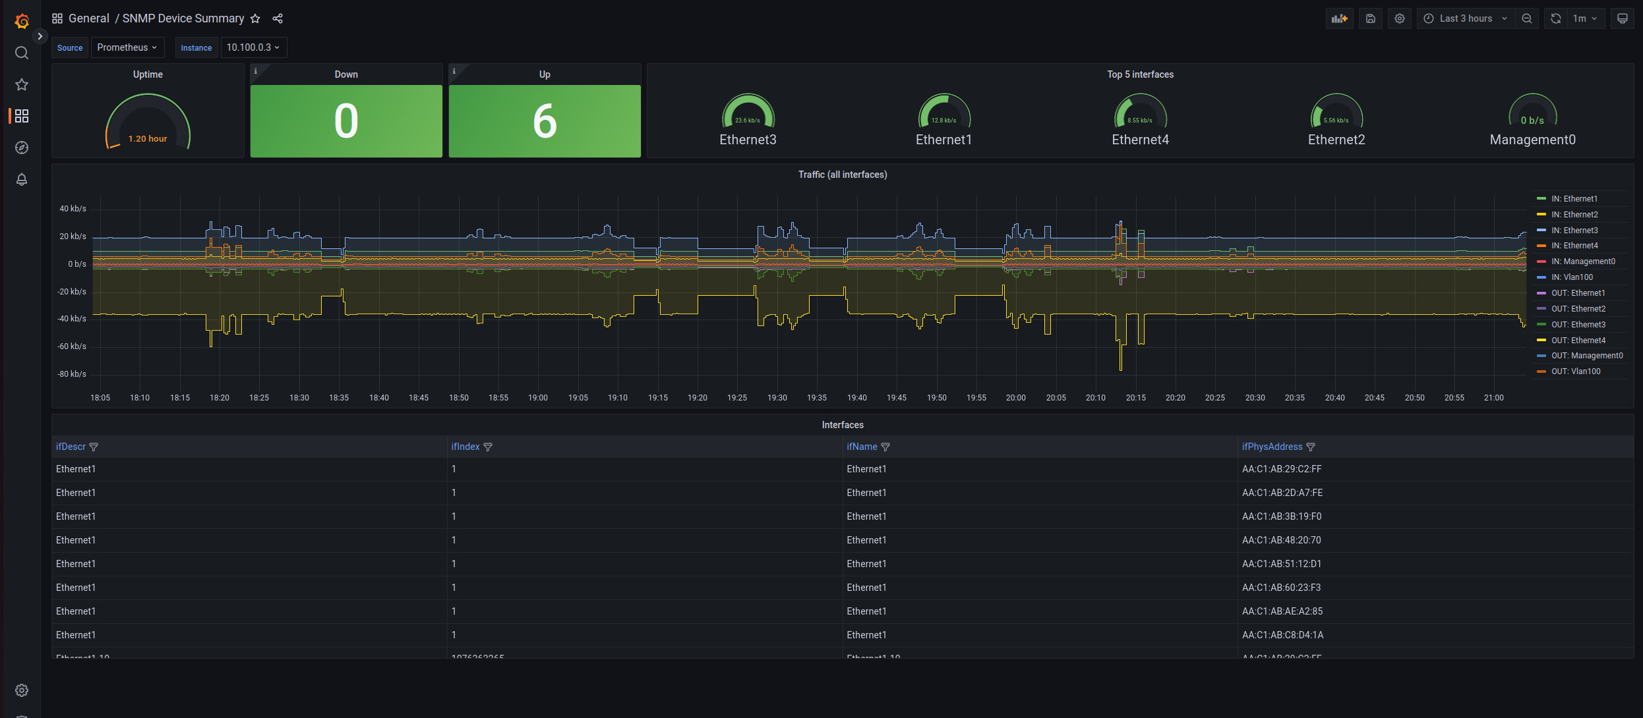
Infrastructure and visualization
Notes:
Infrastructure
Fully implemented network, RIP, OSPF, BGP, and MGMT network
Visualization
SNMP exporter -> Promtheus -> Grafana
gRPC (gnmic) -> Influxdb -> Grafana

Slide 4
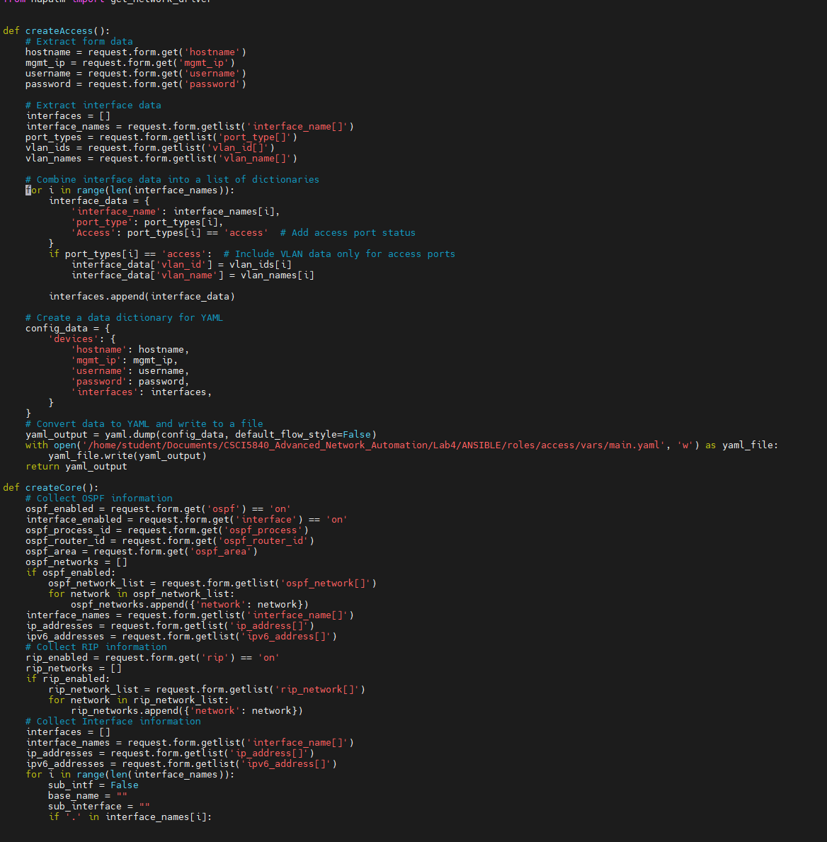
IAC

Slide 5
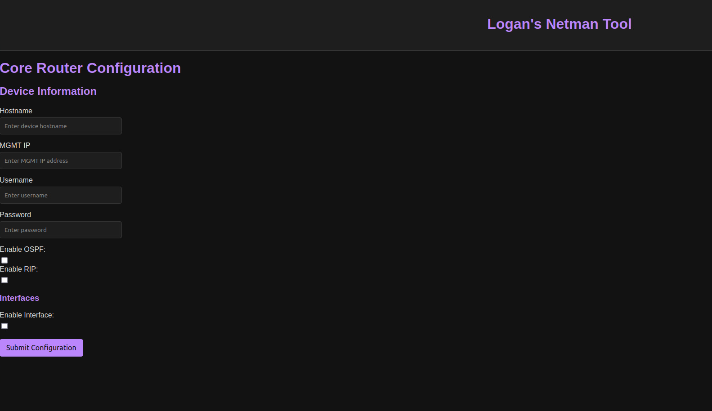
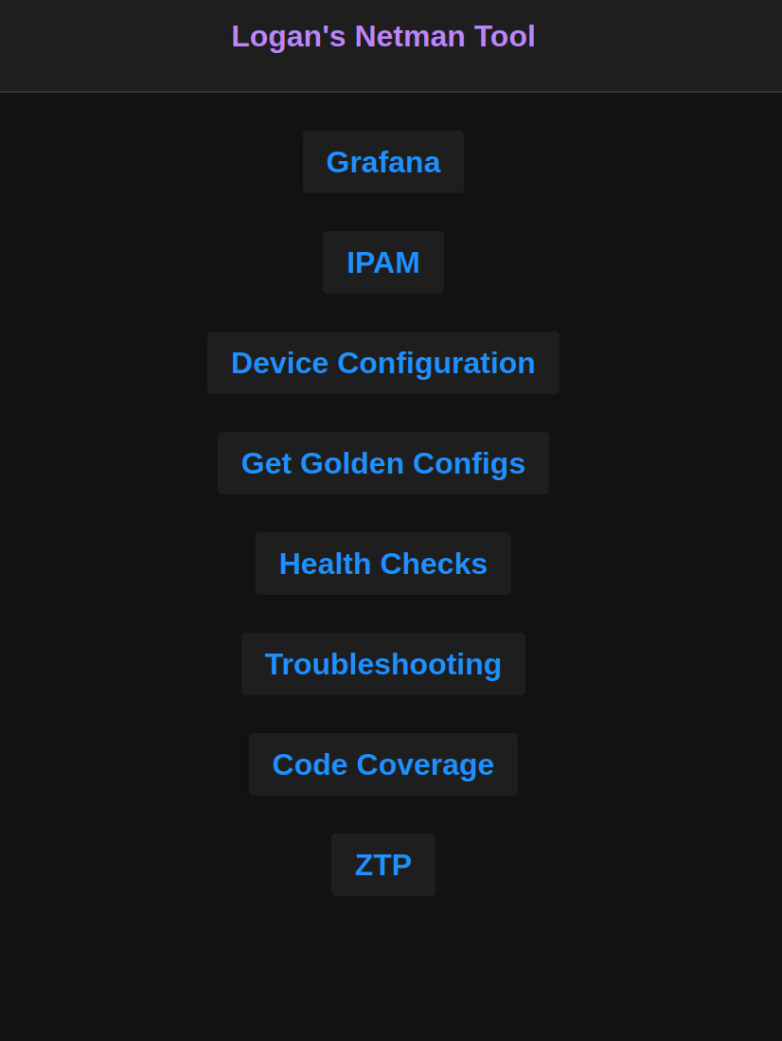
IAC
Features:
Get Golden Configs
YAML -> Ansible -> J2 Auto configuration
Fully implemented GUI (with dark mode)
GitHub Change Management
IPAM via NetBox
Password Change System
Health Checks

Slide 6
Unit Testing / Code Coverage

Slide 7
Features of the tools
Unit Testing: GitHub Actions
Code Coverage: IaC automation
Utilizes a local GitHub Runner to execute code checks like:
IP Connectivity
Password Validation
Expected IaC output
Ping checks
Analyzes all IaC and dynamically calculates code coverage %s:
Calculates for every code and config change
Displays nicely on GUI

Slide 8
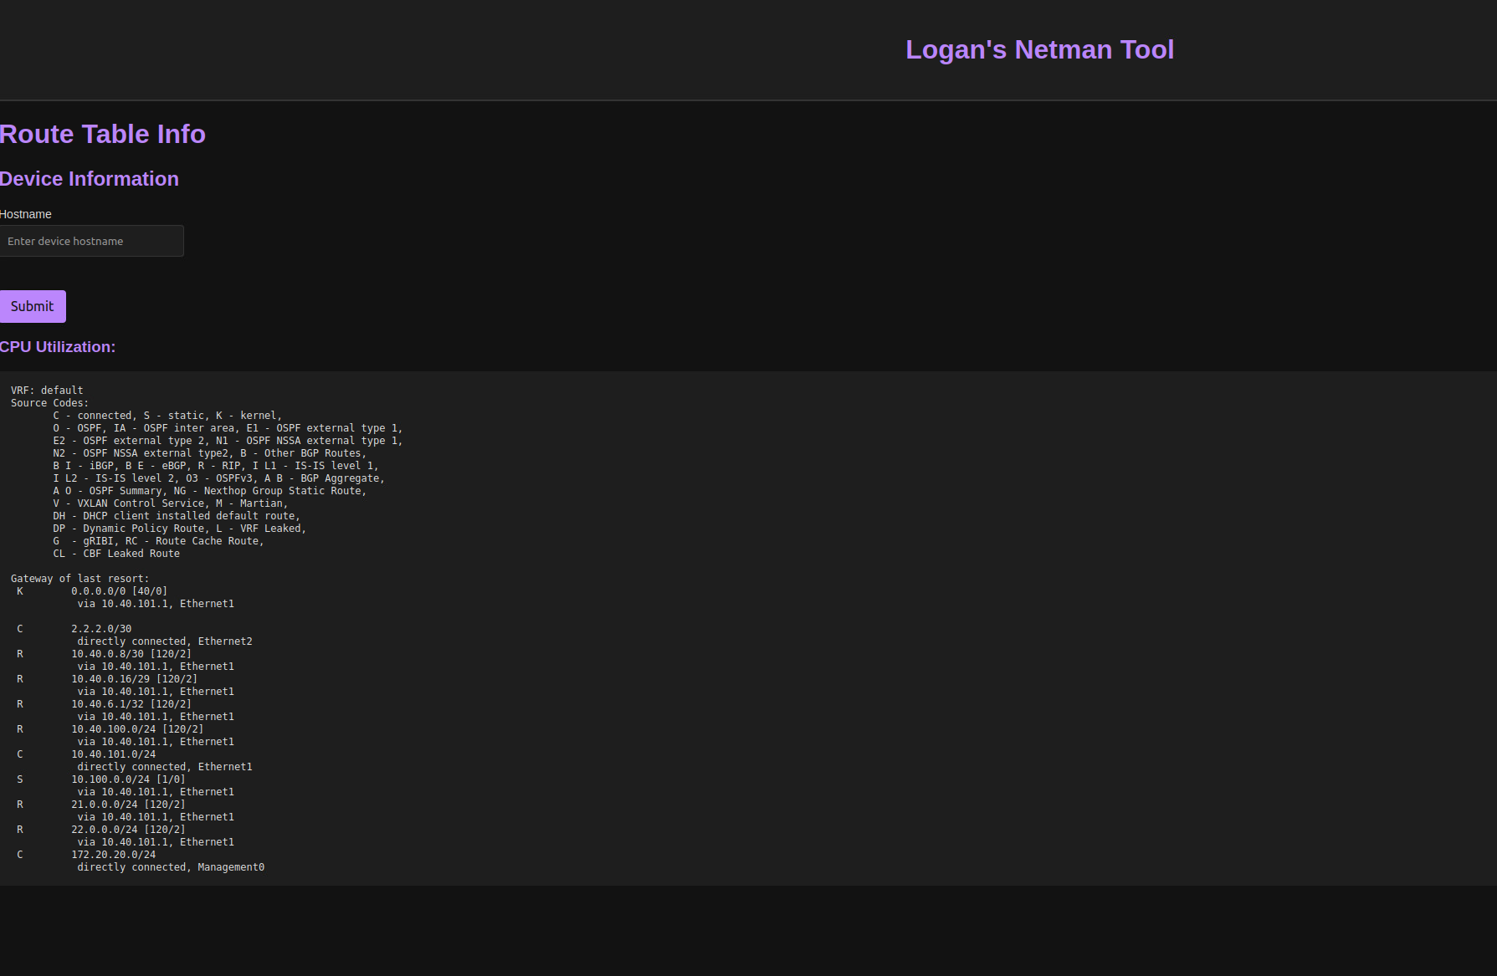
DEMOS
Notes:
Demo:
Grafana
IPAM
Device Config: Core, add OSPF network.
Get Golden Configs
Health Check – Route Table
Code Coverage

Slide 9
THANK YOU
Logan Chayet
303-Robo-Networks
logan@robocontrolnetworks.com
www.robocontrolnetworks.com

